Slide 1
Brief Introduction to Github
Lukas Hoffmann, 8/28/17

Slide 2
Why Github?
git versus Github
Github: version control for collaborative projects
Who changed what, when, and why
Work on different parts, at different times, in different locations, then merge changes smoothly
Complete project archive & documentation
Open access reproducible research
Social network for coders

Slide 3
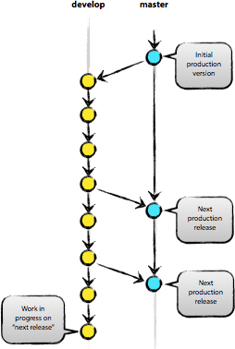
High-level concept
nvie.com/posts/a-successful-git-branching-model/

Slide 4
One-user, one-branch Github pipeline

Slide 5
Prerequisites
Innumerable online resources: swcarpentry.github.io/git-novice/
Need Github account
Need git command line tool
git-for-windows.github.io/ - Git Bash (Windows)
git-scm.com/
Set up some configs: swcarpentry.github.io/git-novice/02-setup/
Free stuff with .edu address: education.github.com/pack

Slide 6
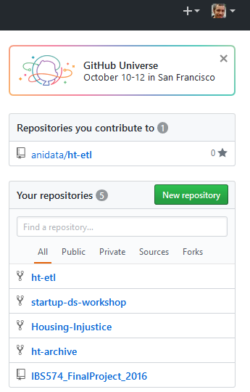
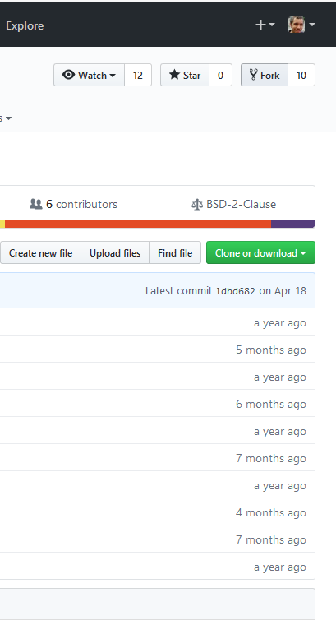
Make new repository or fork repository

Slide 7
Setup a new repo
Pick a license
MIT, Apache, GPL, ...
choosealicense.com/
.gitignore - specifies intentionally untracked files to ignore
Thumbs.db = ignore Thumbs.db files in any folder
/*.txt = ignore all .txt files in current folder
/data/*.txt = ignore all .txt files in data folder
README.md
On command line
cd to your folder
git clone https://github.com/username/reponame
Subsequent git commands should be run inside the reponame folder
Notes:
/data/* or /data/** could make it delete things you don’t want, see https://web.archive.org/web/20140310215100/http://blog.icefusion.co.uk:80/git-stash-can-delete-ignored-files-git-stash-u/
If you add a .gitignore *.txt, but there was previously a tracked .txt file that you had committed, it won’t ignore that file. You can first remove that file from the repo, do a commit, then re-add it to the repo (then it will get ignored). Or use git rm --cached file_to_ignore.txt

Slide 8
Switch to development branch
https://www.gun.io/blog/how-to-github-fork-branch-and-pull-request
https://git-scm.com/book/en/v2/Git-Branching-Basic-Branching-and-Merging
https://www.atlassian.com/git/tutorials/git-merge
https://git-scm.com/book/en/v2/Git-Branching-Branches-in-a-Nutshell

Slide 9
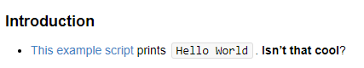
Start hacking
Add src/helloworld.py
print(“Hello World”)
Add documentation to README.md
### Introduction
[This example script](src/helloworld.py) prints ```Hello World```. **Isn't that cool**?
Markdown syntax: guides.github.com/pdfs/markdown-cheatsheet-online.pdf
Markdown preview: MarkView

Slide 10
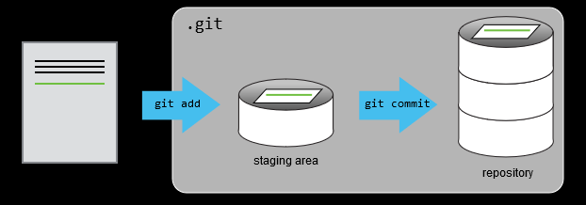
Stage and commit
git status – shows project status
“Git sees every file in your working copy as one of three things:
tracked - a file which has been previously staged or committed;
untracked - a file which has not been staged or committed; or
ignored - a file which Git has been explicitly told to ignore.” (Slideshare)
git add –A – track all files
git commit –a –m “Added helloworld script”
git push origin master - sync local machine changes to online repo
Notes:
"remote" is just some git repository not on your computer (e.g. on github). "origin" is the repository you cloned your repository from (e.g. the one on your github). "master" is just the name of the default branch. ... Origin is the default name for a remote repository, but you may change that. https://www.quora.com/What-does-git-remote-and-origin-mean

Slide 11
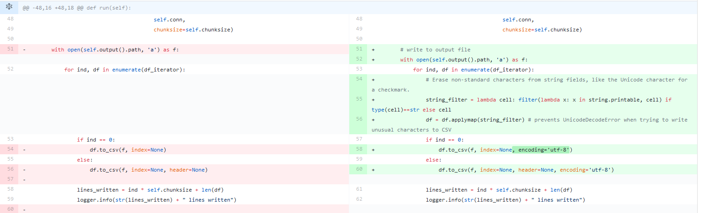
View changes in browser
stackoverflow.com/questions/2529441/how-to-read-the-output-from-git-diff

Slide 12
Undo mistakes (only use locally)
github.com/blog/2019-how-to-undo-almost-anything-with-git
Restore a single file
git log –oneline – view identifiers for prior commits
git checkout c6fab02 src/helloworld.py – restore old version of file from previous commit
git commit –a –m “restore helloworld.py from commit c6fab02”
Restore everything to where it was after a previous commit, as if previous commits never happened (use with caution).
git reset --hard c6fab02
For undoing commits pushed to Github, safest to just fix it locally and push a new commit.

Slide 13
Merge branch to master

Slide 14
Moving toward collaboration
git pull
git fetch
git merge
Issues
Branches & merging
Forks & pull requests

Slide 15
Much more to learn!

